Slide 1


Pandas library
DATA ANALYTICS BOOTCAMP | IRONHACK
https://pandas.pydata.org/

Slide 2


PANDAS LIBRARY: WHY?
Standard Python variables, doesn't include the possibility to load tabular data.
Why we don’t use a numpy array to store tabular data?
Pandas library was developed to solve this problem. This library includes a new type of variable called dataframe or "df" (another convention of the coding community).
Moreover, the Pandas library comes with several methods to deal with this new type of variable.
To use the pandas library use:
import pandas as pd

Slide 3
PANDAS LIBRARY: WHY?
In addition, Pandas library introduced another type of variable called series.
Pandas series is equivalent to a Python dictionary with keys and values.
Pandas dataframes are built combining several Pandas series based on common keys.
Moreover, the Pandas library comes with several methods to deal with this new type of variable.
To use the pandas library use:
import pandas as pd

Slide 4
CHECKING OUR PANDAS VERSION
Pandas API can have changes from version to version.
Therefore, it is very import to check out which version we have installed in our computer.
Moreover, we need to access the right version of the documentation.
Pandas official documentation
We can check out which version of Pandas library we have in our computers by typing:
pd.__version__

Slide 5
READING DATA FILES WITH PANDAS
Pandas library is able to read data from many file formats as:
CSV: (All the columns are separated by comma or semicolon)
TXT: (The fields are separated by TABS (\t))
EXCEL: (Simple excel files)
JSON: (Javascript variable files)
00

Slide 6
READING CSV FILES WITH PANDAS
How we can read a "csv" file?
To this end, Pandas library has a function: pd.read_csv(filename)
If the file is a “txt” you need to provide an the additional keyword: “sep” specifying the field separator
import numpy as np
import pandas as pd
# Reading data
file1 = pd.read_csv('file1.csv')
file2 = pd.read_csv('file2.txt', sep = '\t')

Slide 7
READING EXCEL FILES WITH PANDAS
We can read Excel files in Pandas!
How we can read Excel files? Using the function: pd.read_excel()
If it doesn’t work type on a “code” cell and try again:
!conda install xlrd
00

Slide 8
PANDAS SERIES AND DATAFRAMES
Pandas adds two new objects:
Series
DataFrames
Series:
Are equivalent to Python dictionaries.
The elements are accessed by “key”.
The “key” can be str or numerical.
DataFrames:
Are tables of data in which every rows and column has:
Label
Implicit index (like any Python list)
Can be seen as the junction of several Pandas Series which have common “keys”

Slide 9
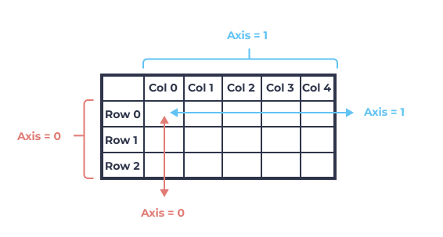
COMBINING MULTIPLE PANDAS DATAFRAMES TOGETHER
To concatenate the content of two or more dataframes you can use the method: concat()
# Data blending
new_df = pd.concat([df1,df2], axis=0)
New_data.shape
# axis=0 -> concatenate one df2 at the bottom of df1 (they need to have the same columns)
00

Slide 10
RENAMING THE COLUMNS OF A PANDAS DATAFRAME
We can obtain the column’s names using:
df.columns
To rename the columns we can use two approaches:
df.columns = list_of_new_column_names
Using he method: rename() to your dataframe (df).
The rename(columns=dict) method needs a dictionary where:
“keys” are the current column names
“Values” are the new column names
# renaming columns
df = df.rename(columns={ 'controln':'id','hv1':'median_home_val', 'ic1':'median_household_income'})

Slide 11


